Slide 1

Telsa Autopilot
Breaking down Tesla's AI Day presentations (Part 1I)
Gene Olafsen

Slide 2

overview
Part I
Tesla Vision
Planning and Control
Part II
Manual Labeling
Auto Labeling
Simulation
Part II
HW Integration
Dojo

Slide 3
Acknowledgement and Reference
The screenshots and content is largely taken from the AI Day presentations.
Tesla AI Day - YouTube
1612.03144.pdf (arxiv.org)

Slide 4
Data
The story of datasets is critical.
The hundreds of millions of parameters must be set correctly for the neural networks to make 'correct' predictions.
Datasets in the vector space must be clean and diverse.

Slide 5
topics
Manual Labeling
Auto Labeling
Simulation
Scaling Data Generation

Slide 6
Labeling history
About four years ago, Tesla was using a third-party to obtain datasets.
High latency to get the datasets and the quality was not 'amazing'.
In the spirt of full vertical integration at Tesla, the data acquisition and labeling task was brought in house.

Slide 7
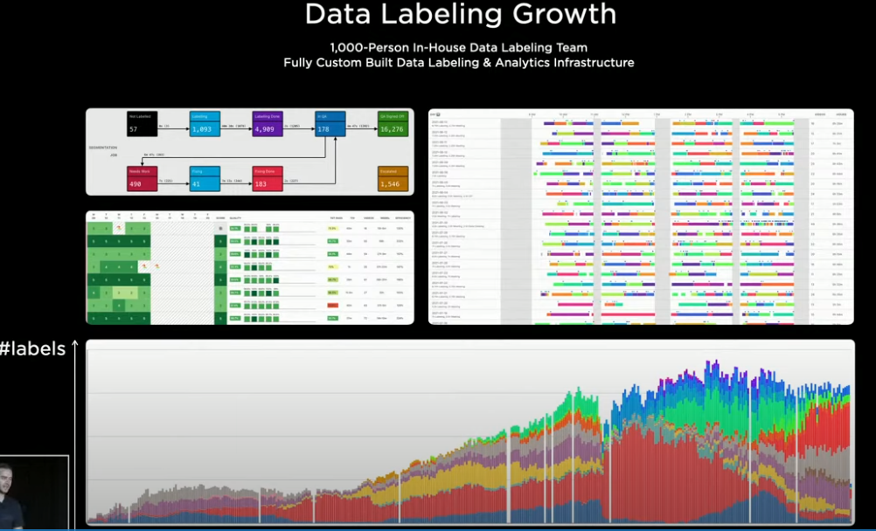
Vertical integration
Currently there is a 1,000 person labeling team that works very closely with the engineers.
All the infrastructure that supports the labeling process was built from scratch.

Slide 8
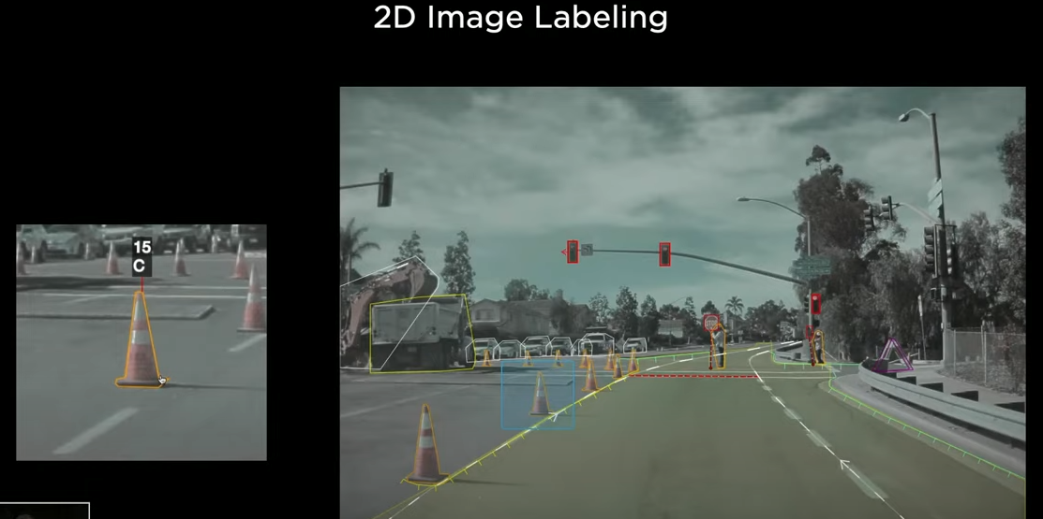
Image space labeling
Four years ago, most of the labeling was performed in image space.
A lot of time is spent annotating and drawing bounding boxes around objects.

Slide 9
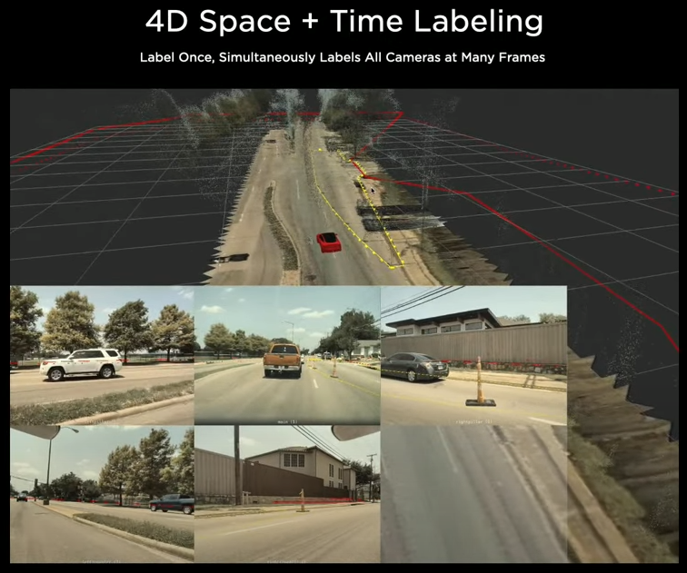
Labeling
Directly labeling in vector space.
This is a reconstruction of the ground plane on which the car drove.

Slide 10
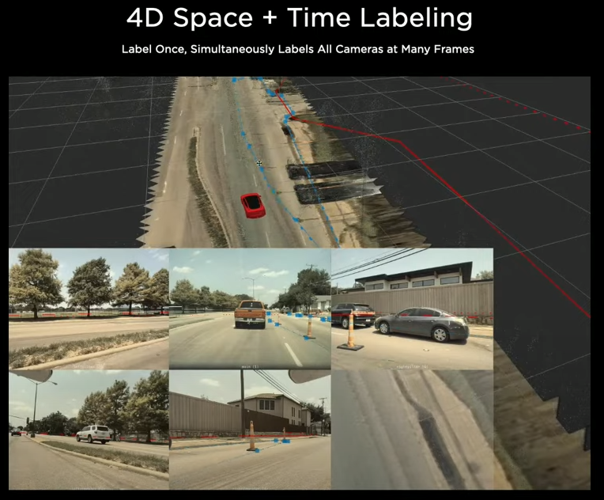
Human/computer collaboration
The labels are produced in vector space and being re-projected into the images.
This system increases labeling throughput by 100X.
However, this was not good enough because people are good at semantics while computers excel at geometry, reconstruction, triangulation, tracking.

Slide 11
Auto labeling
The task of training the network requires many more human labeling experts.
Tesla has invested in a massive auto-labeling pipeline.

Slide 12
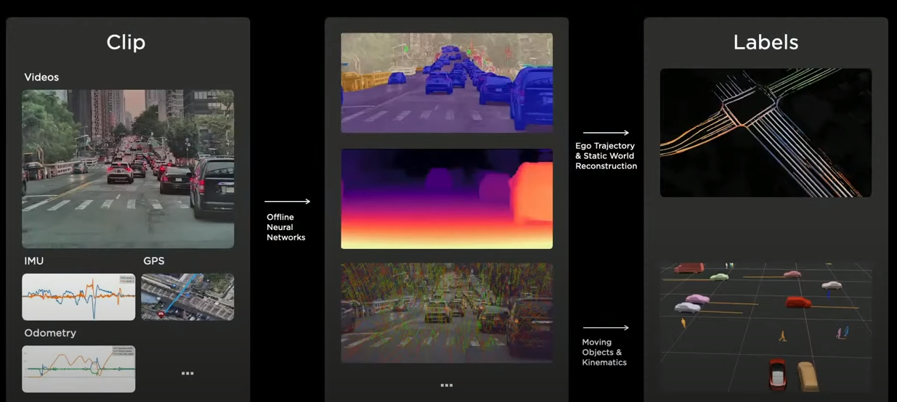
Life of a clip

Slide 13
Clip processing
A clip has dense sensor data and may contain up to a minute of video.
Acquired from either engineering test cars or customer cars.
Pipeline servers produce segmentation masks, depth, etc.
Then on to other processing which creates the labels and produces the data to train the networks.

Slide 14
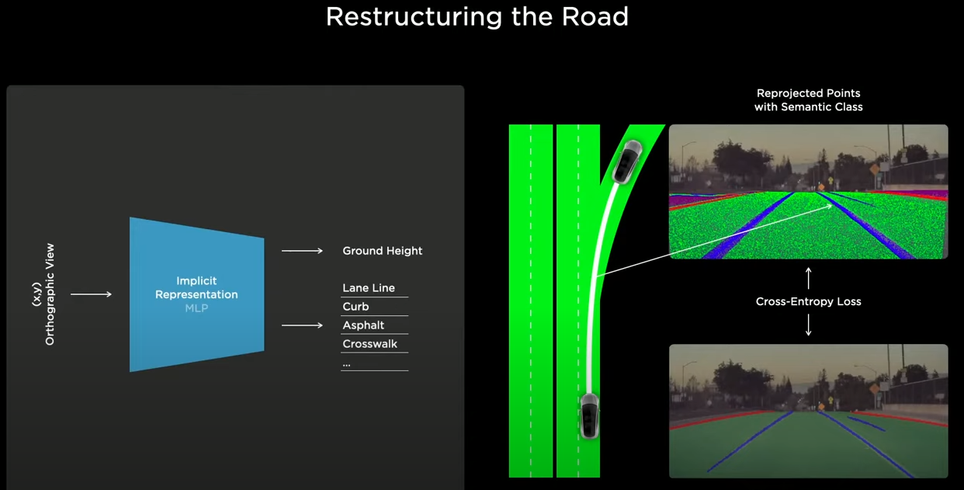
Road identification
The first task is to label the road surface, which can typically be represented by splines or meshes.
Tesla uses a technique that queries XY points on the ground and asks for the height as well as various semantics: curbs, lane boundaries, etc.
Given an XY, you get a Z and this 3D point can be projected into all the camera views.

Slide 15
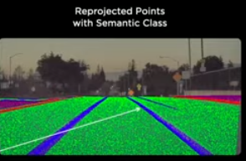
points
The system makes millions of these queries and calculates lots of points. And all the points are re-projected into all the camera views.

Slide 16
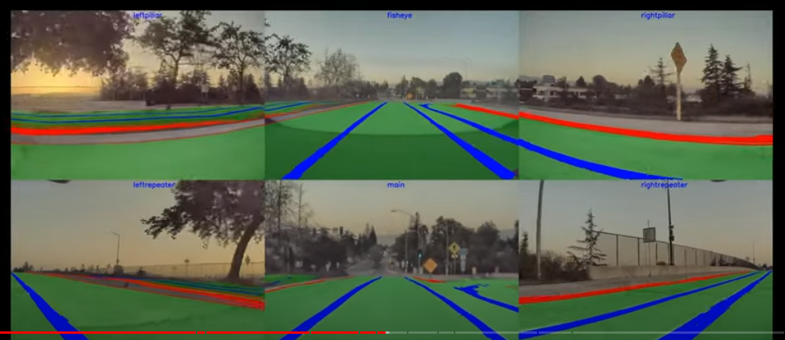
Reconstructing the road
The points are consistent across space and time.

Slide 17
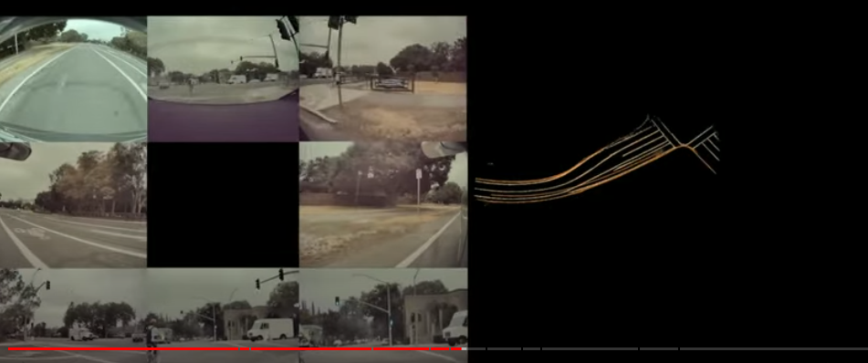
Reconstruct the road from a single car
Using this technique a car can map out the path around the car.

Slide 18
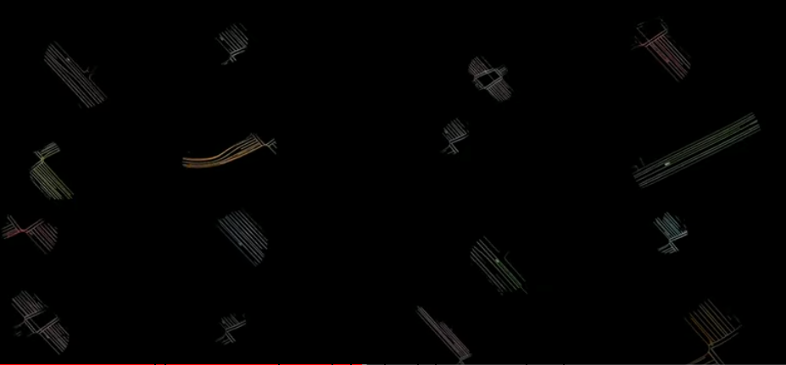
Collect different trips in the same location
A location can be collected by the same car or different vehicles.

Slide 19
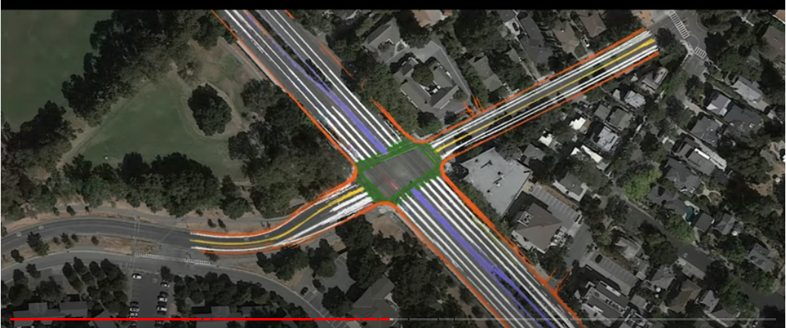
Combined Trips
Here 16 trips are composited together for the same intersection.
This labels both where the car drove, but other parts of the road as well. A good way to check that the labels of the points from other vehicles are in agreement.
Human labelers can then clean up any noise.

Slide 20
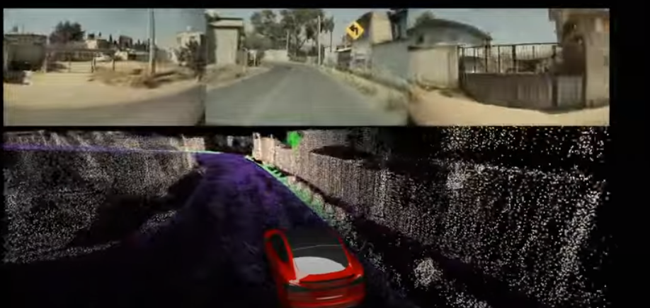
Wall, barriers, etc.
A reconstructed 3D point cloud of walls and other obstacles.
Notice the high density of the point cloud.

Slide 21
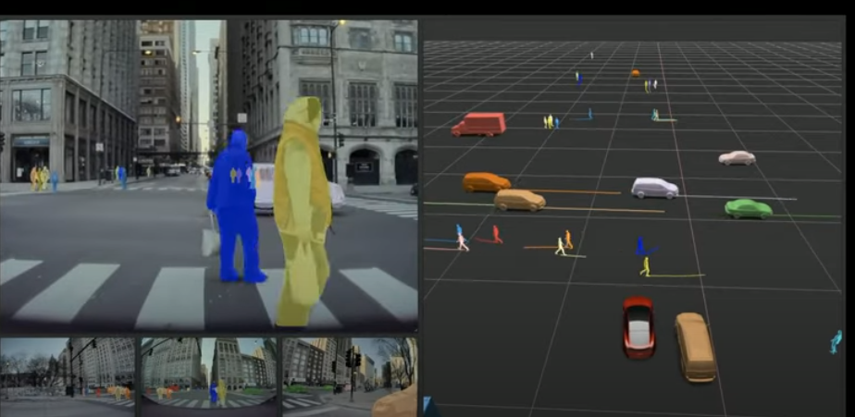
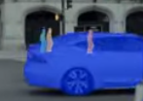
Occuled actors
The advantage of working with the data offline, is the benefit of hindsight.
The velocity of any actor can be tested by predicing the velocity, acceleration, direction, etc. and then comparing the guess to the actual values.
The system can even predict actors that are occluded.
The planner needs to know these possible behaviours, even if they are occluded.

Slide 22
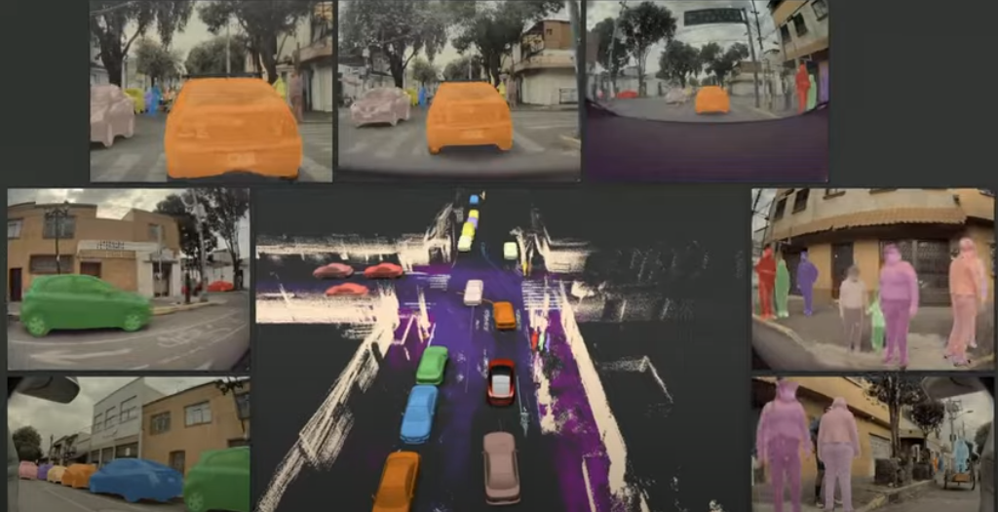
Combined
Putting it all together.
Tesla trains on a million+ clips.

Slide 23
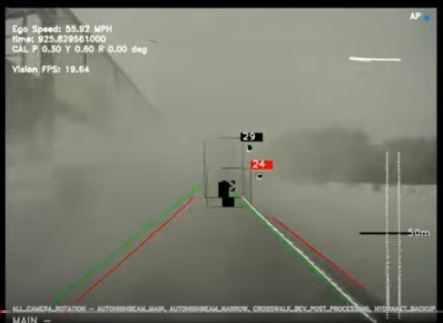
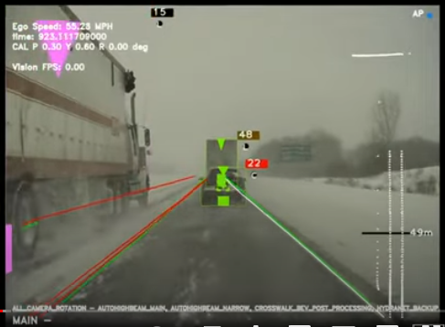
No radar
Truck dumps snow from roof on a moving car.
The car does not 'remember' the car in front of it in poor visibility.
Tesla removed RADAR within three months

Slide 24
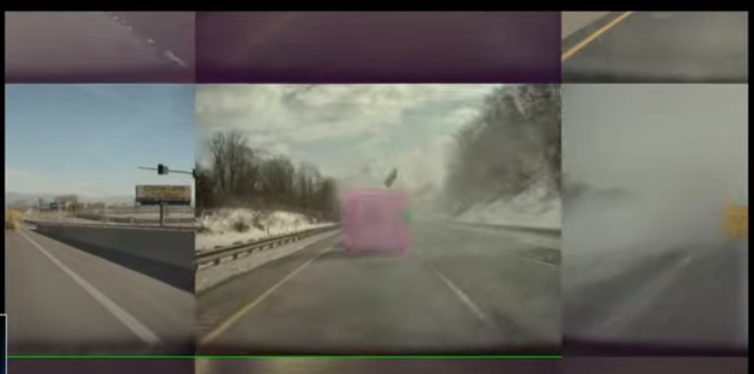
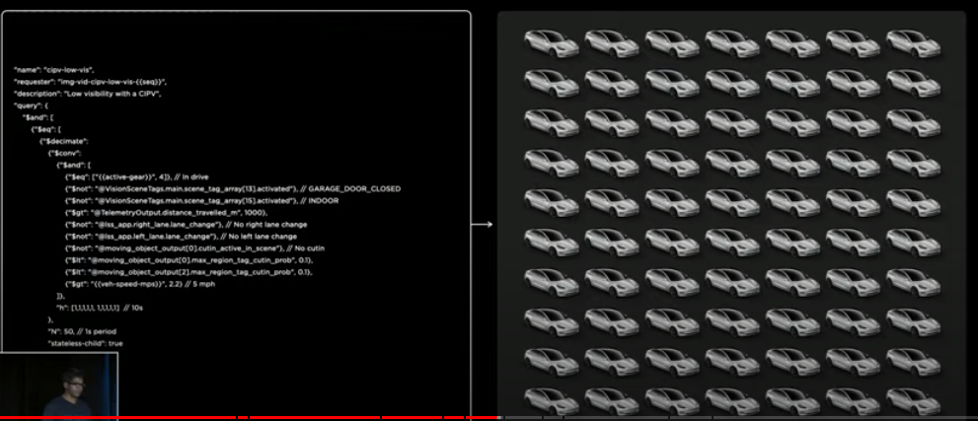
Similar events
They had their fleet of vehicles find similar conditions.
10K similar clips were collected and labelled in a week.

Slide 25
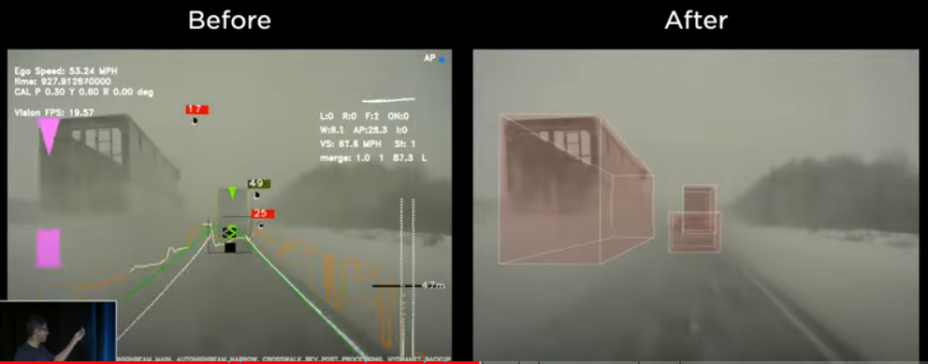
vehicle persistence
The system now remembers when conditions deteriorate.

Slide 26
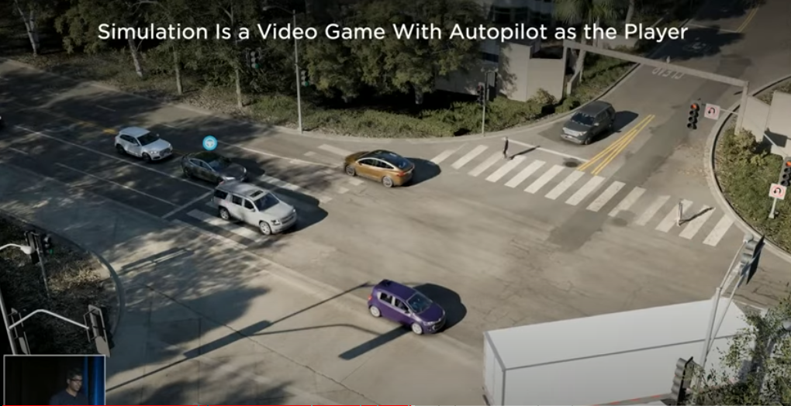
simulation
Point cloud data can be used to create a simulation from any camera angle.
Autopilot is controlling the car with the icon over the roof.

Slide 27
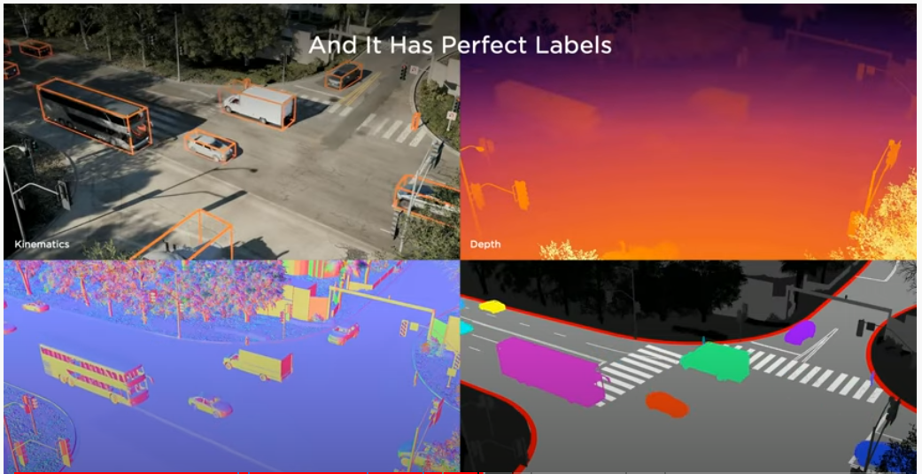
Perfect labels
The simulation space has perfect labels.
Kinematics
Depth
Surface Normals
Segmentation

Slide 28
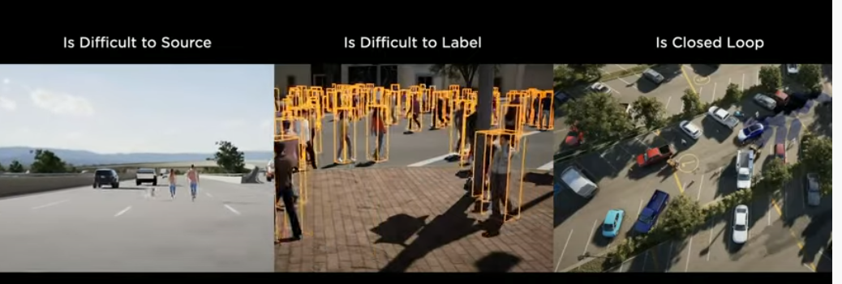
Why simulation
Scenes that are rare or situations that need to be considered.
Scenes that could take 'forever' to label.
Vary situations with small adjustments.

Slide 29
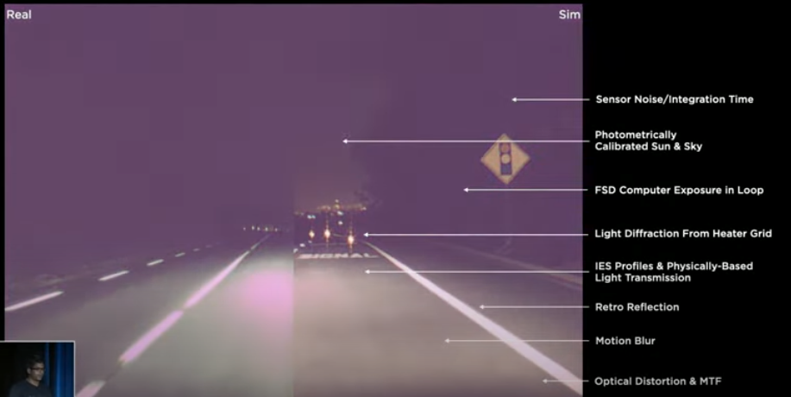
Accurate camera simulation
The simulation must match what the real cameras 'see'.
Model properties of the camera.
The simulation can even be used to help with sensor design and placement.

Slide 30
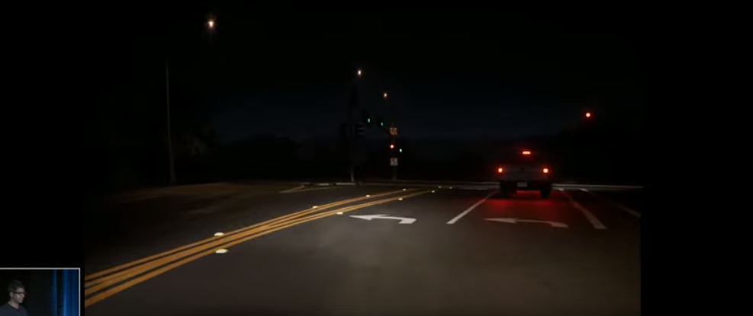
Photorealistic
The simulation is ray traced.
The goal is to be visually indistinguishable from reality.
This rendering system also has a NN stack to add more realism.

Slide 31
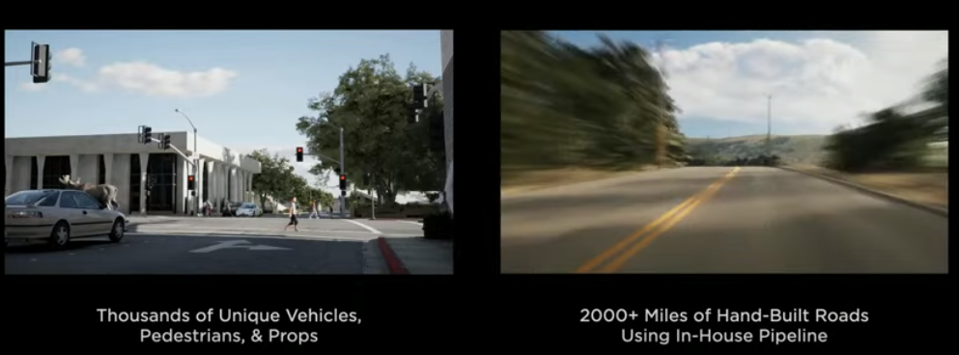
Diverse actors and location

Slide 32
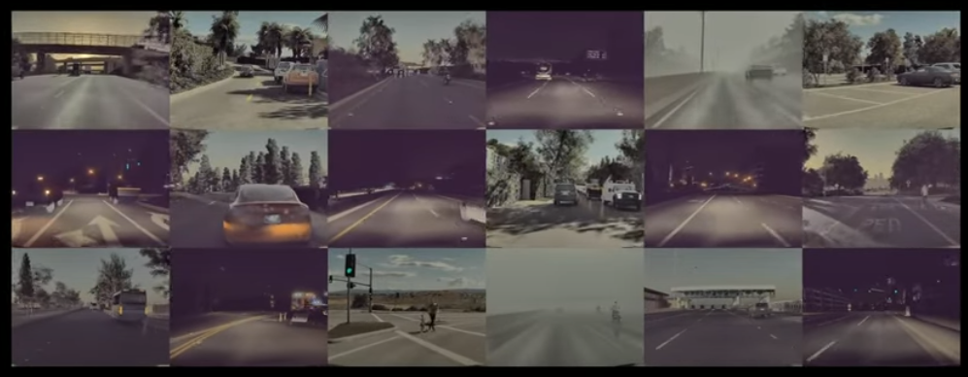
Scene generaton
Scenes are generated by hand, proceduraly and ML-based adversarial.
When Autopilot encounters a situation where it fails- many more scenes are created around the failure point to learn/train solutions.

Slide 33
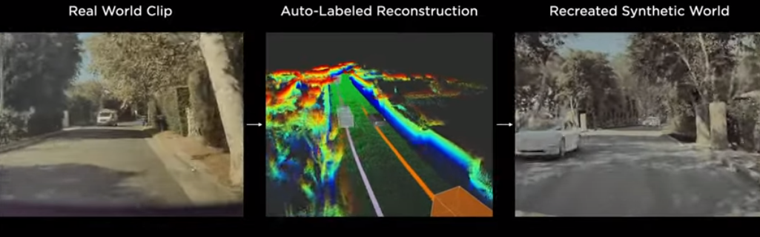
Real -> Synthetic
Building a pipeline to replicate scenarios and environments anywhere a Tesla vehicle has driven.

Slide 34
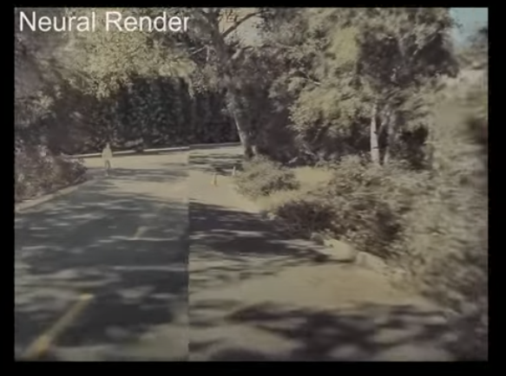
Enhance with neural render
Lefthand side was captured by the cameras.
Righthand side is rendered from the simulation pipeline.

Slide 35
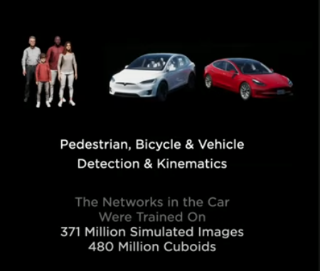
Simulation today
A half-billion labels.

Slide 36
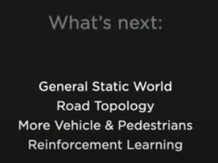
Future simulation
In the next several months, these are the tasks that will be included.

Slide 37
Scaling data generation
To get rid of the RADAR sensor
10+ billion labels
2.5 million clips
Compute was scaled across thousands of GPUs and about 20K CPU cores.
Included in the comput loop were over 2,000 Autopilot system cores.
This is Tesla's smallest comput cluster.

Slide 38
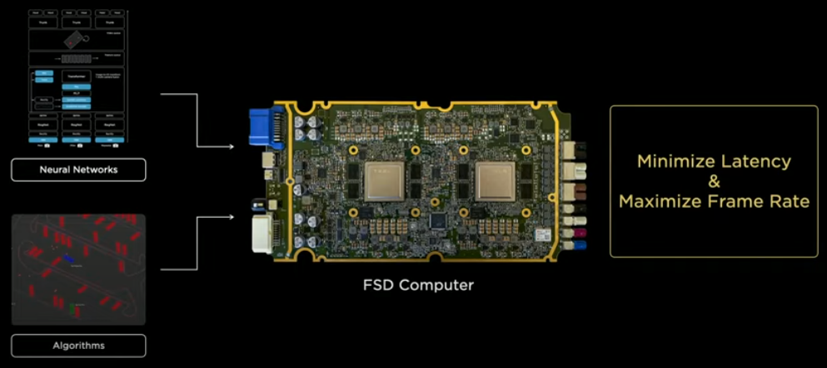
Hardware integration
Minimizes Latency and maximizes framerate

Slide 39
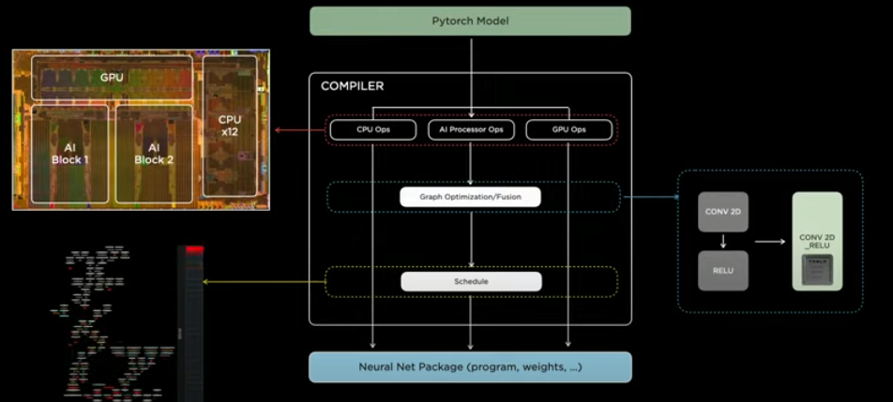
Neural net compiler
The jobs that need to be run on the vehicle are scheduled for throughput.

Slide 40
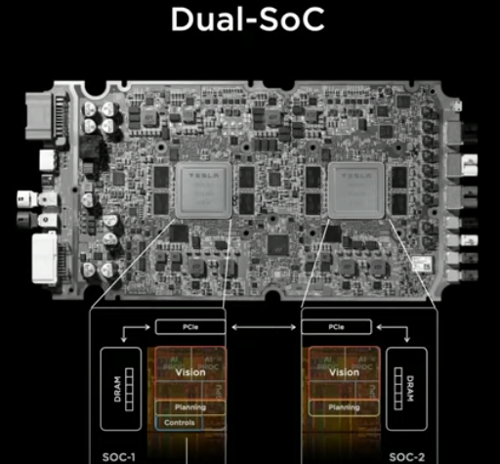
Two compute engines
Only one has control of the car at a time.
The other is used as a compute extension.
Those roles are interchangeable.

Slide 41
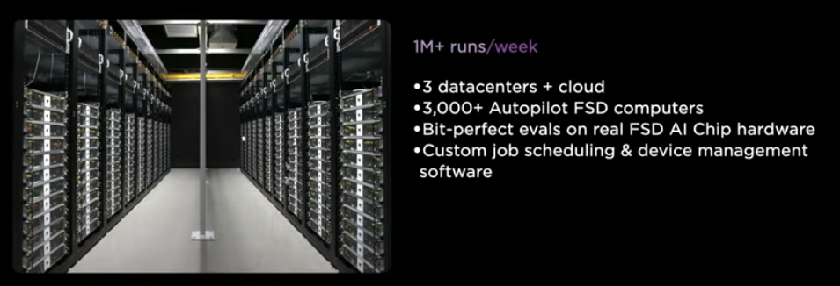
AI Evaluation Infrastructure
Tesla runs a million evaluations a week for any code change that the team produces.

Slide 42
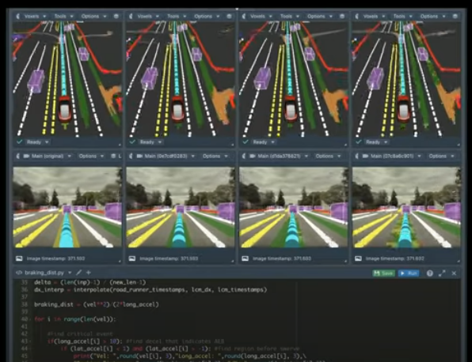
tools
This tool compares the output of code revisions to iterative video clips.

Slide 43
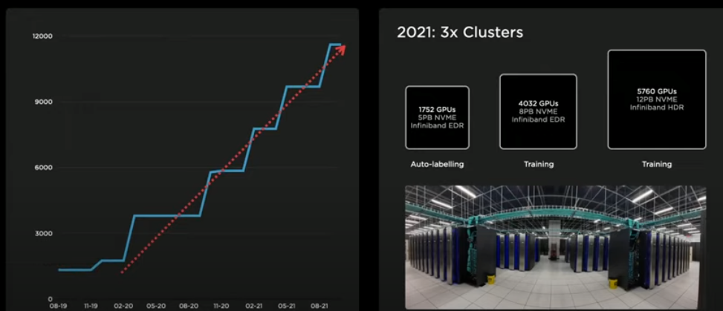
Training compute
Just shy of 10K GPUs.
Which is more than the top 5 supercomputers in the world.

Slide 44
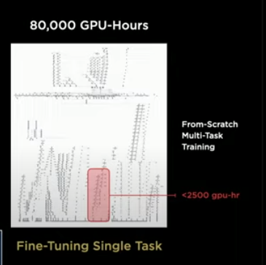
Introducing Dojo
A super fast training computer.

Slide 45
goals
Achieve best AI training performance
Enable larger and more complex NN models
Power efficient and cost effective compute

Slide 46
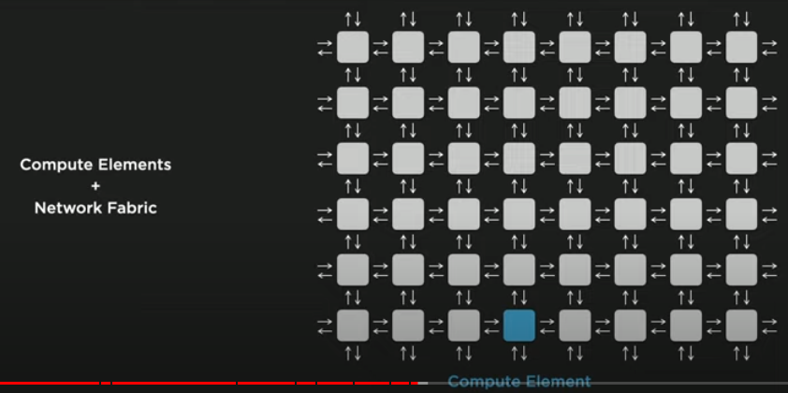
Distributed compute architecture
Very easy to scale the compute.
Difficult to scale bandwidth.
Extremely difficult to reduce latency.

Slide 47
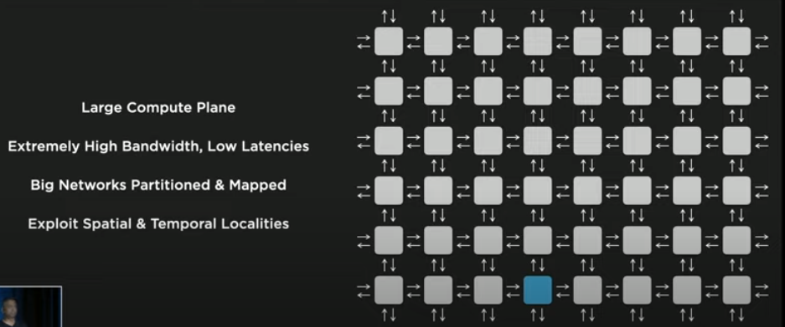
Dojo architecture
Large compute plane filled with robust compute elements, backed with a large pool of memory and interconnected with high bandwidth/low latency fabric. (2D mesh)
Big neural networks are partioned and mapped to extract parallelism.
Neural compiler (of Tesla's design) will exploit spacial and temporal locality to reduce communication demands- bandwidth communication can keep scaling as the compute plan grows.

Slide 48
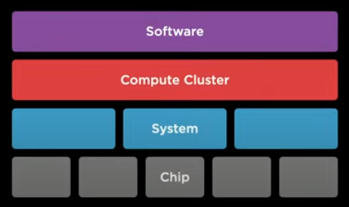
Performance and all levels
Tesla wants to attack the problem at all levels.

Slide 49
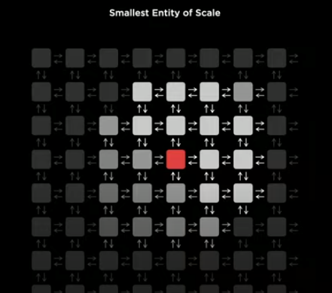
Training node
The smallest compute entity and is designed to provide seemless scaling.
If it is too small, it runs fast, but synchronization and software will not scale.
If it is too big, it will complex to implement, and produce memory bottleneck issues.

Slide 50
Optimizing bandwith and latency
Picked the farthest a signal could travel in a very high clock cycle (2+ GHtz)
They 'drew' a box around that distance and filled it with wires, giving the highest bandwidth that can feed the box.
Then added ML compute and a large pool of SRAM.
Finally a programmable control core.

Slide 51
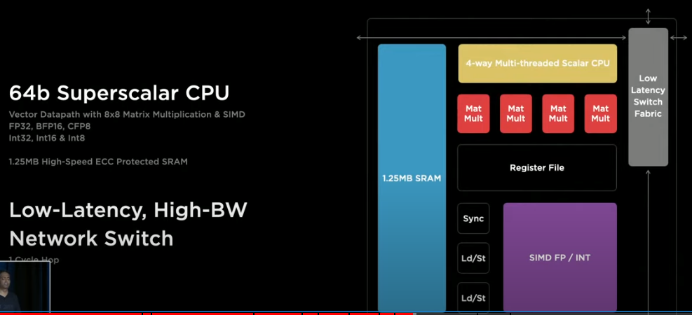
High-performance training node
Smallest entity of scale defined.

Slide 52
Packing a punch
More than one terra-flop of compute (BF16/CFP8)
64 GFLOPS for FP32
512 GB/s transfer in each cardinal direction

Slide 53
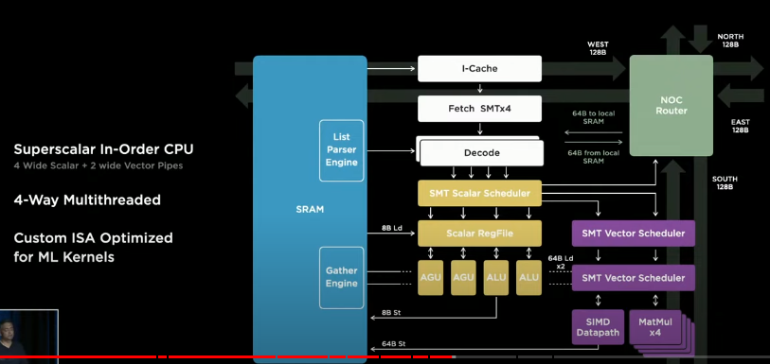
architecture
A capable architecture that can do compute and data transfer simultaneously.
Fully optimized for ML workloads.

Slide 54
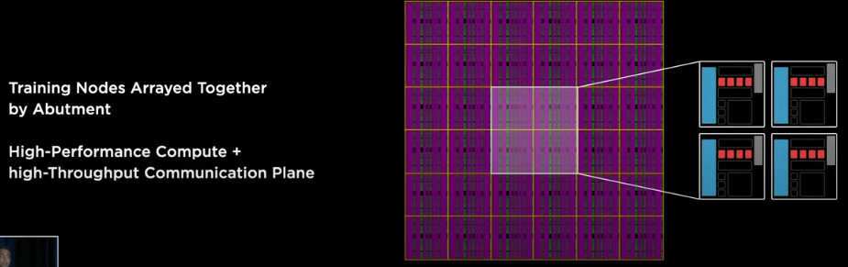
modular
Physically, the training node is designed to reside next to other training nodes in any direction.

Slide 55
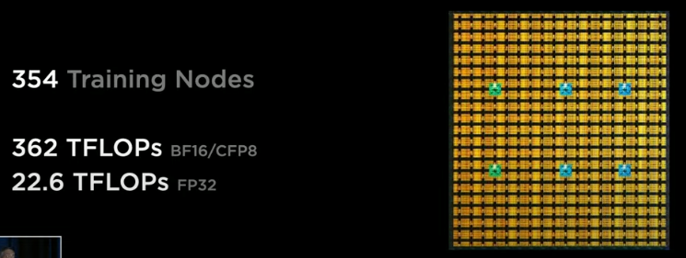
Compute array
The high bandwidth fabric supports 10TBps bi-directional throughput on a chip.

Slide 56
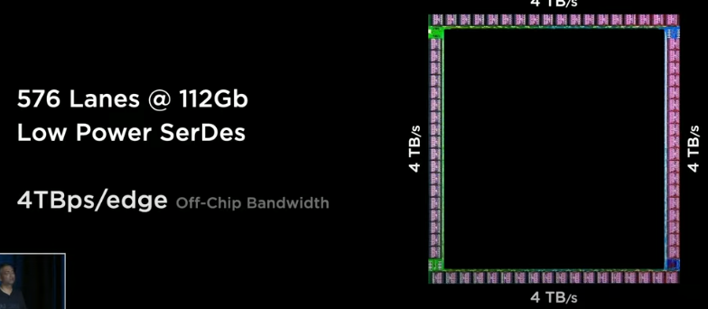
I/o ring
More than two times the throughput of the state of the art network switch chips.

Slide 57
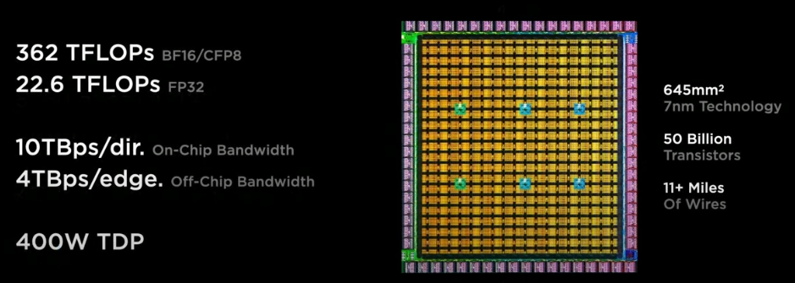
D1 chip
100% of the area is used for ML or bandwidth support.
GPU-level compute with CPU-level flexibility.

Slide 58
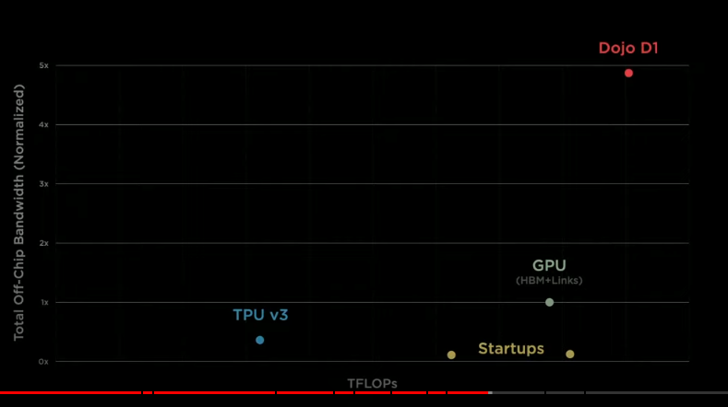
D1 chip excels

Slide 59
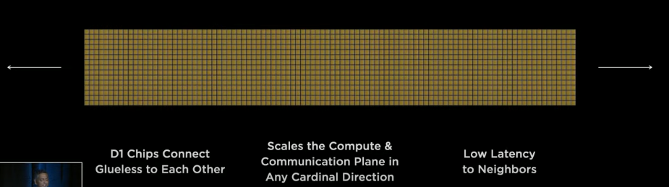
Super scale
D1 chips connect to each other without additional hardware, Tesla put 500,000 training nodes together to form their compute plane.
1,500 D1 chips connected together.

Slide 60

Dojo at scale
Then they added Dojo Interface Processors as the host bridge, connected PCI Gen4 interfaces.

Slide 61

Training tile
A training tile consists of 25 known 'good' Dojo processors.
The maximum bandwidth is preserved.
A high-density, high-bandwidth connection preserves the bandwidth coming out of the training tile.
9 PFLOPs BF16/CFP8
Massive 36TB/s off-tile bandwidth
Larges multi-chip-module in the industry

Slide 62


Power delivery
To power the tile, Tesla created voltage regulators that re-flowed directly on top of each Dojo chip.
Integrated the electrical, mechanical and thermal pieces with a 52VDC input.

Slide 63


Training tile
Unprescedented integration.

Slide 64

First functional tile
On a limited cooling bed, Tesla was able to run GPT2 on the compute tile.

Slide 65

Sample training matrix
A 2x3 tile tray is a sample training matrix, with two trays in a cabinet.
Tesla assembled 10 cabinets with 1.1 ExaFlop capability.
120 training tiles, 3,000 Dojo chips, >1M traing nodes

Slide 66

Logical view of the system
Not every job requires a huge cluster. The compute plan can be subdivided into sections that can be used for different workloads.

Slide 67

How does a user leverage this system?
Minimal code change to scripts.

Slide 68

Dojo compiler engine
The compiler uses multiple techniques to extract the most performance from the compute configuration.
The compiler can handle highly dynamic control flows, such as loops and if/then/else branches.

Slide 69

Software stack
Extensions to PyTorch.
Custom profilers and debuggers that work with the new stack.

Slide 70
Fastest AI Training computer
4X performance (at the same cost)
1.3X Better Performance per Watt
5X smaller footprint

Slide 71

Thank You
Tesla AI Overview

